Slide 1
Intrinsic Radiosensitivity
The outcome of radiation exposure depends on
The DNA lesions that are caused and their persistence
How cells and tissues ‘sense’ danger and respond by activating cell survival or death pathways

Slide 2
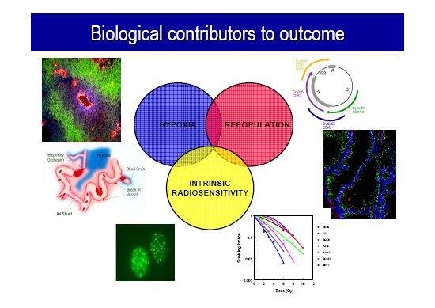

Slide 3
DSB repair, checkpoint arrest, and cell death are all part of the DNA damage response to DSBs. They function synergistically to dictate whether cells live or die following IR and to prevent development of chromosome instability.
The relationship of repair, cell proliferation and cell death following IR has been the subject of many studies, primarily because, clinically, loss of reproductive, clonogenic cells following RT determines the outcome of cancer treatment.

Slide 4
Cell Cycle
M phase
0.5-1 hr
G2 phase
1-2 hrs
G0 quiescent
S phase
DNA synthesis
6-8 hrs
G1 phase
variable length
If all cells in a population are dividing
Mitotic Index (M.I.) = λTm / Tc
Labeling Index (L.I.) = λTs /Tc
Where λ is a correction for uneven cell numbers due to mitosis (0.69)

Slide 5
Cell Cycle and Radiosensitivity
1
Variations in sensitivity and in cell cycle arrest after irradiation could be important in radiation therapy, because fractionated irradiation can lead to sensitization by reassortment.
The oxygen enhancement ratio (OER) does not vary much with the phase of the cell cycle.
High LET responses are less affected by cell cycle phase than low LET radiation responses.
S.F.
LATE S
.1
EARLY S
G1 PHASE
G2/M PHASE
.01
0
0
4
8
12
16
20
Dose (Gy)
Increasing radioresistance
G1 S G2 M

Slide 6
Radiobiology: normal tissues
Sparing of normal tissues is essential for good therapeutic outcome
The radiobiology of normal tissues may be even more complex as the one of tumours:
  different organs respond differently
  there is a response of a cell organization not just of a single cell
  repair of damage is in general more important

Slide 7
Different tissue types
Serial organs (e.g. spine)
Parallel organs (e.g. lung)

Slide 8
Different tissue types
Serial organs (e.g. spine)
Parallel organs (e.g. lung)
Effect of radiation on the organ is different

Slide 9
Volume effects
The more normal tissue is irradiated in parallel organs
  the more chance that a whole organ fails
The greater the volume the smaller the dose should be
In serial organs even a small volume irradiated beyond a threshold can lead to whole organ failure (e.g. spinal cord)

Slide 10
Classification of radiation effects in normal tissues
Early or acute reactions
  Erythema
  Nausea
  Vomiting
  Tiredness
Occurs typically during course of RT or within 3 months
Late reactions
  Telangectesia
  Spinal cord injury, paralysis
  Fibrosis
  Fistulas
Occurs later than 6 months after irradiation

Slide 11
Classification of radiation effects in normal tissues
Early or acute reactions
Late reactions
Late effects can be a result
of severe early reactions:
consequential radiation injury

Slide 12
Late effects
Often termed complications
Can occur many years after treatment
Can be graded:
        RTOG / EORTC
        CTCAE v3
        WHO

Slide 13
A comment on vascularisation
Blood vessels play a very important role in determining radiation effects both for tumours and for normal tissues.
Vascularisation determines oxygenation and therefore radiosensitivity
Late effects may be related to vascular damage

Slide 14
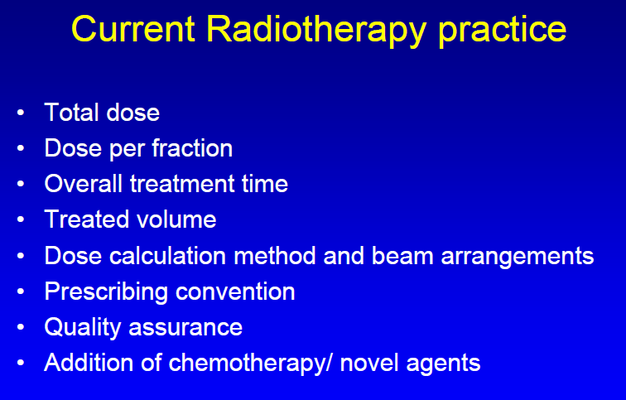

Slide 15
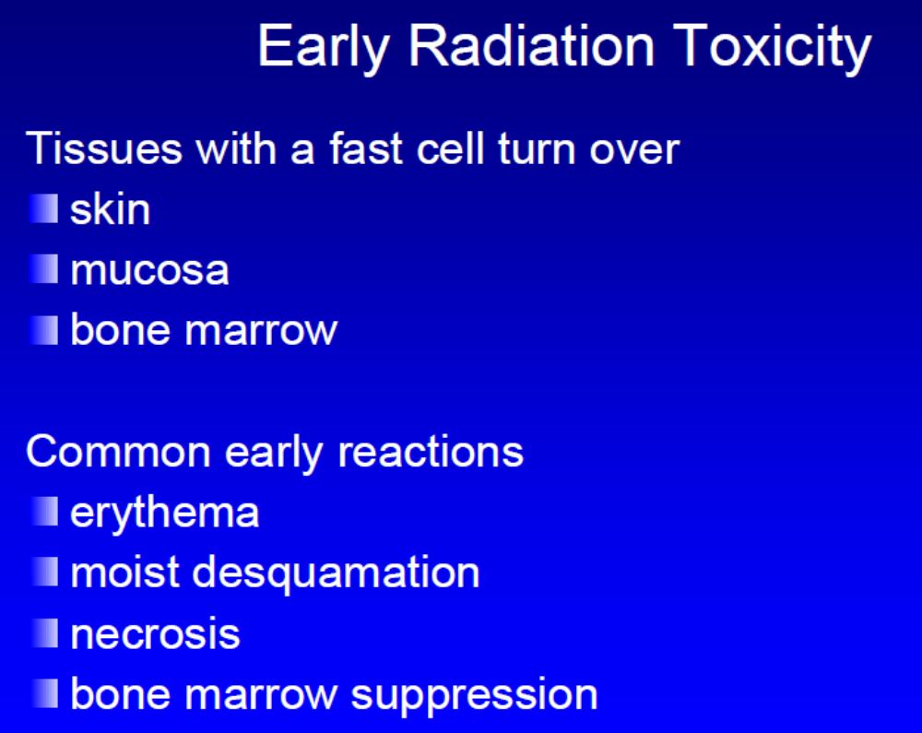

Slide 16
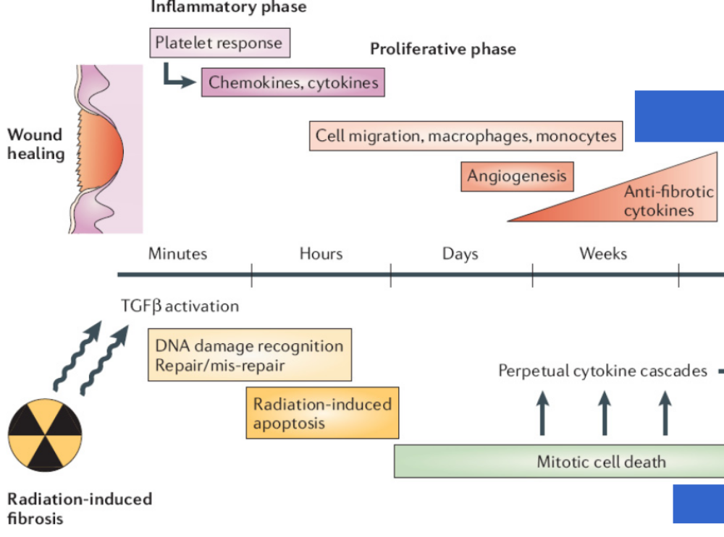

Slide 17
T and acute responding normal tissues
Acutely responding normal tissues, showing a rapid cellular turnover, have a proliferative response to reproductive cell death due to radiation induced DNA damage as early as in the first week of treatment.
T_{k} value of oral mucosa cells is 7 days and T_{pot} is 1-3 days.
Cellular suppresion and regeneration precede the expresion of acute mucosal reactions (acute mucositis), which are caused by a reduction of the functional cell population following the impairment of cellular supply from the proliferative compartment.

Slide 18
T and late responding normal tissues
Late responding normal tissues with a slow rate of self renewal do not show cellular depletion and functional damage until after the end of conventional RT.
Therefore, no opportunity exists for repopulation during treatment.
Times of onset of repopulation of the spinal cord range from 120-150 days.
T is therefore a negligible factor in the induction of late reactions.

Slide 19
T and late responding normal tissues
This is true only for genuine late effects – whose incidence and severity are not related to the severity of early effects.
For consequential late effects – those whose severity is strictly related to the severity of acute effects – the impact of T is essentially related to its effects on early toxicity.

Slide 20
Impact of fraction size on tumor and normal tissues response
Radiobiological data show that both H&N tumores and acutely tissues are less sensitive to change in fraction size then late responding tissues.
The sensitivity to changes in fraction size for each tissue can be quantified with the use of the α/β ratio which marks the shape of the fractionation response.
Dose per fraction is the dominant factor in determining late effects.

Slide 21
Impact of fraction size on tumor and normal tissues response
A high α/β ratio (7 - 20 Gy), as in acutely responding tissues and in tumors, indicates a more linear survival response of the target cells.
A low α/β ratio (0,5 – 6 Gy), as in late responding tissues, defines a survival curve of the target cells that is significantly curved.
Therefore, the effects of fractionation are relatively larger in the latter than in the former tissues.

Slide 22
Relevance of Radiobiology to Clinical Fractionation Protocols
Conventional treatment:
Tumors are generally irradiated with 2Gy dose per fraction delivered daily to a more or less homogeneous field over a 6 week time period to a specified total dose
The purpose of conventional dose fractionation is to increase dose to the tumor while PRESERVING NORMAL TISSUE FUNCTION
Deviating from conventional fractionation protocol impacts outcome
How do you know what dose to give; for example if you want to change dose per fraction or time? Radiobiological modeling provide the guidelines. It uses
  Radiobiological principles derived from preclinical data
  Radiobiological parameters derived from clinical altered fractionation protocols
    hyperfractionation, accelerated fractionation, some hypofractionation schedules
The number of non-homogeneous treatment plans (IMRT) and extreme hypofractionated treatments are increasing. Do existing models cope?

Slide 23
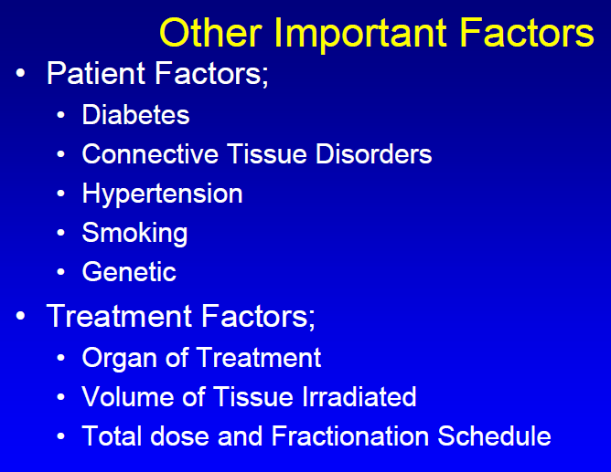

Slide 24
Radiobiology: normal tissues
Sparing of normal tissues is essential for good therapeutic outcome
The radiobiology of normal tissues may be even more complex as the one of tumours:
  different organs respond differently
  there is a response of a cell organization not just of a single cell
  repair of damage is in general more important

Slide 25
Response to Fractionation Varies With Tissue
1
1
Acute Responding
Tissues α/β = 10Gy
Fractionated
Late Effects
S.F.
S.F.
.1
.1
Fractionated
Acute Effects
Late Responding
Tissues - α/β = 2Gy
Single Dose
Late Effects
α/β = 2Gy
Single Dose
Acute Effects
α/β = 10Gy
α/β is high (>6Gy) when survival curve is almost exponential and low (1-4Gy) when shoulder is wide
.01
.01
0
0
0
4
8
12
16
20
0
4
8
12
16
Dose (Gy)
Dose (Gy)
Fractionation spares late responding tissues

Slide 26
80
α/β=3Gy; 1.5Gy/fx
α/β=30Gy; 1.5Gy/fx
70
2.0Gy/fx
α/β=30Gy; 4Gy/fx
60
D new
50
α/β=3Gy; 4Gy/fx
40
30
20
20
30
40
50
60
70
80
D old
Note how badly late responding tissues respond to increased dose/fraction

Slide 27
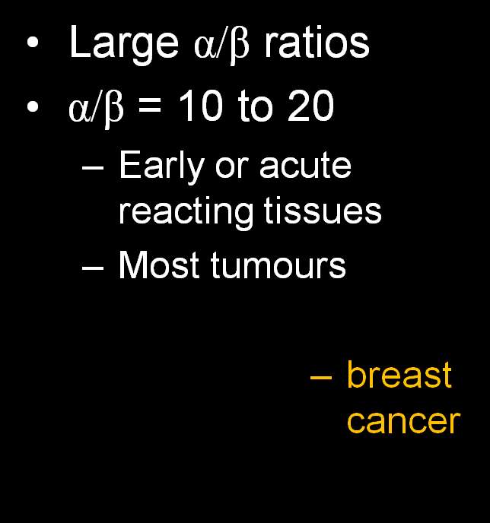
α/β ratios
Small α/β ratio
α/β = 2
  Late reacting tissues, e.g. spinal cord
  potentially prostate cancer

Slide 28
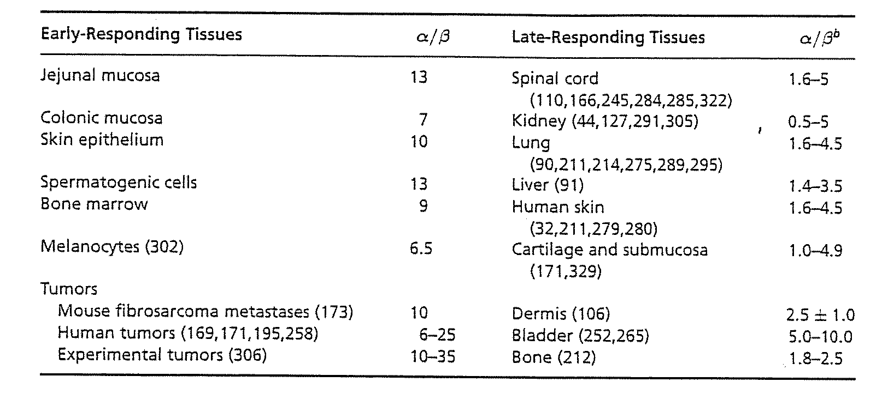
Sensitivity of Tissue to Dose Fractionation can be estimated by the α/β ratio

Slide 29
Repair
“Repair” between fractions should be complete - N.B. we are dealing with tissue recovery rather than DNA repair
  Correction for incomplete repair is possible
In general, time between fractions for most tissues should be >8 hours
Some tissues, such as CNS, recover slowly making b.i.d. treatment inadvisable
  CHART analysis HNC showed that late morbidity was less than would be expected assuming complete recovery between fractions
  Is the T1/2 for recovery for late responding normal tissues 2.5-4.5hrs?
Notes:
Fractionation spare late tissues

Slide 30
Regeneration in Normal Tissues
The lag time to regeneration varies with the tissue
In acute responding tissues,
  Regeneration has a considerable sparing effect
    In human mucosa, regeneration starts 10-12 days into a 2Gy Fx protocol and increases tissue tolerance by at least 1Gy/dy
  Prolonging treatment time has a sparing effect
  As treatment time is reduced, acute responding tissues become dose-limiting
In late responding tissues,
  Prolonging overall treatment time beyond 6wks has little effect, but
  prolonging time to retreatment may increase tissue tolerance

Slide 31
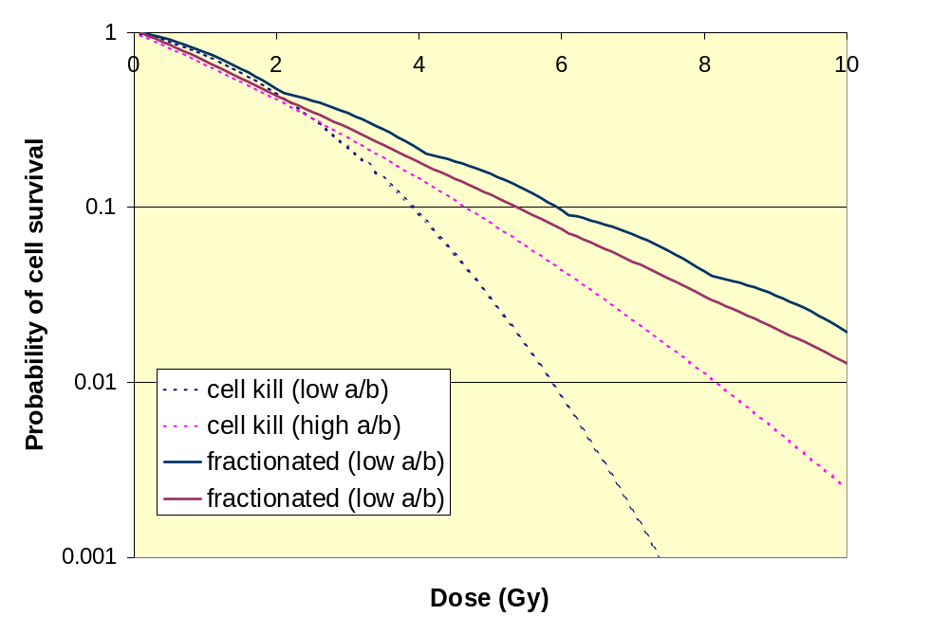
Fractionation
Tends to spare late reacting normal tissues - the smaller the size of the fraction the more sparing for tissues with low α/β

Slide 32
Important assumptions:
  There is full repair between two fractions
  There is no proliferation of tumour cells - the overall treatment time does not play a role.

Slide 33
Reoxygenation
Redistribution
Repair
Repopulation (or Regeneration)
Radiosensitivity

Slide 34
Repopulation/ Regeneration
Normal tissue repopulation is an important mechanism to reduce acute side effects from e.g. the irradiation of skin or mucosa
Radiation schedules must allow sufficient regeneration time for acutely reacting tissues.

Slide 35
Normal tissue tolerance
The tolerance doses is critically dependent on:
• the total dose
• the fractionation schedule
• the volume of normal tissue irradiated
• TD 5/5 = 5% probability of severe sequelae in 5 years
• TD 50/5= 50% probability of severe sequelae in 5 years

Slide 36
• What is the “pathology” of radiation damage
• LQ-model
• pathophysiology
• mechanisms of repair
• How is radiation damage evaluated and categorized?
• RTOG-EORTC, LENT-SOMA, CTCAE vs. 3.0
• Radiation damage of specific organs
• Which factors might influence radiation damage?

Slide 37
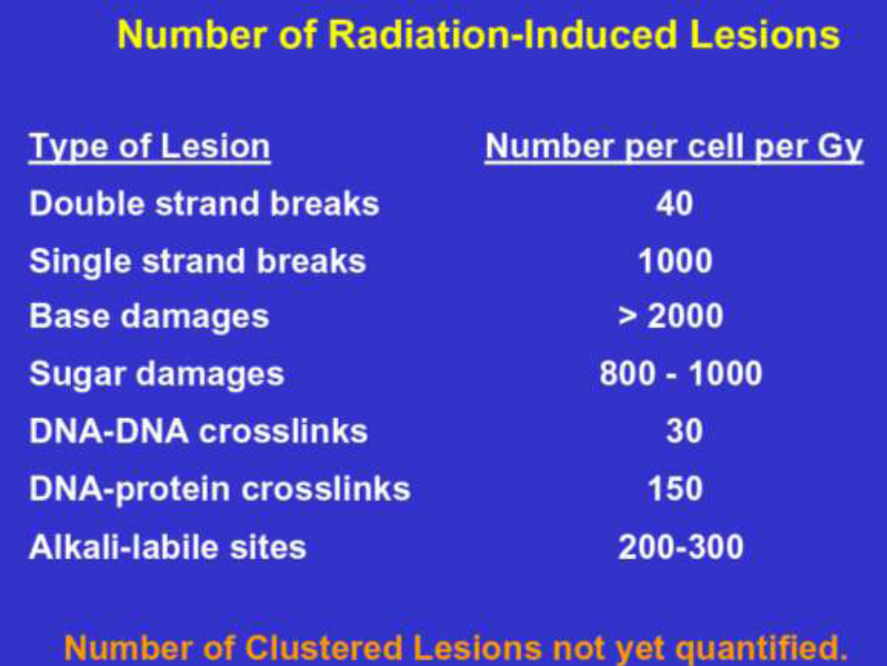
Pathophysiology of radiation damage

Slide 38
Pathophysiology of radiation damage
• half-time of repair
• long (1 – several hours)
skin, kidney, spinal cord
• intermediate (30-60 min)
colon, lung
• shortest (< 30 min)
jejunal mucosa
• interfraction interval: > 8 hours to avoid late toxicity due to incomplete repair

Slide 39
Normal tissue tolerance
• we have radiation damage to cells
• SSB, DSB and other DNA lesions
• we have multiple repair-mechanisms
• fast, intermediate, slow
• we have different kinds of cell-death
• reproductive (mitotic), apoptotic, G1-arrest
• How can we use this knowledge to predict radiosensititvity?

